Slide 1
SQL intro

Slide 2
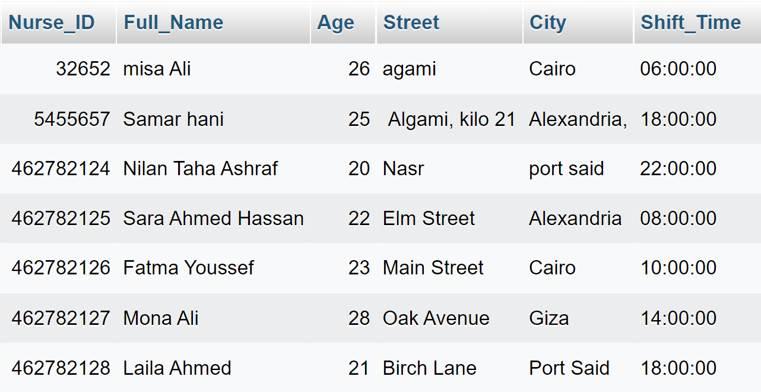
What is SQL?
Column
Structured query language (SQL) is a programming language for storing and processing information in a relational database.
row
Relational Database Management Systems (RDMS) like MySQL, MS Access, Oracle, Sybase, Informix, Postgres, and SQL Server use SQL as their Standard Database Language.

Slide 3
What SQL can do?
Create DB, Table, view
Set permissions on table
Retrieve data
From databases
Delete records or table from DB
Update record in DB

Slide 4
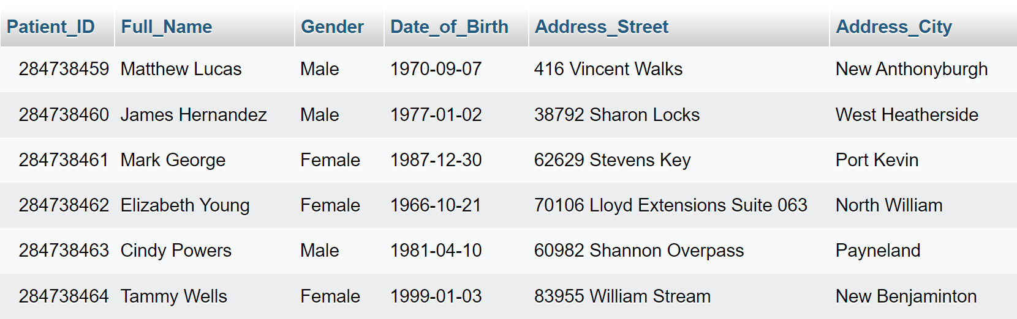
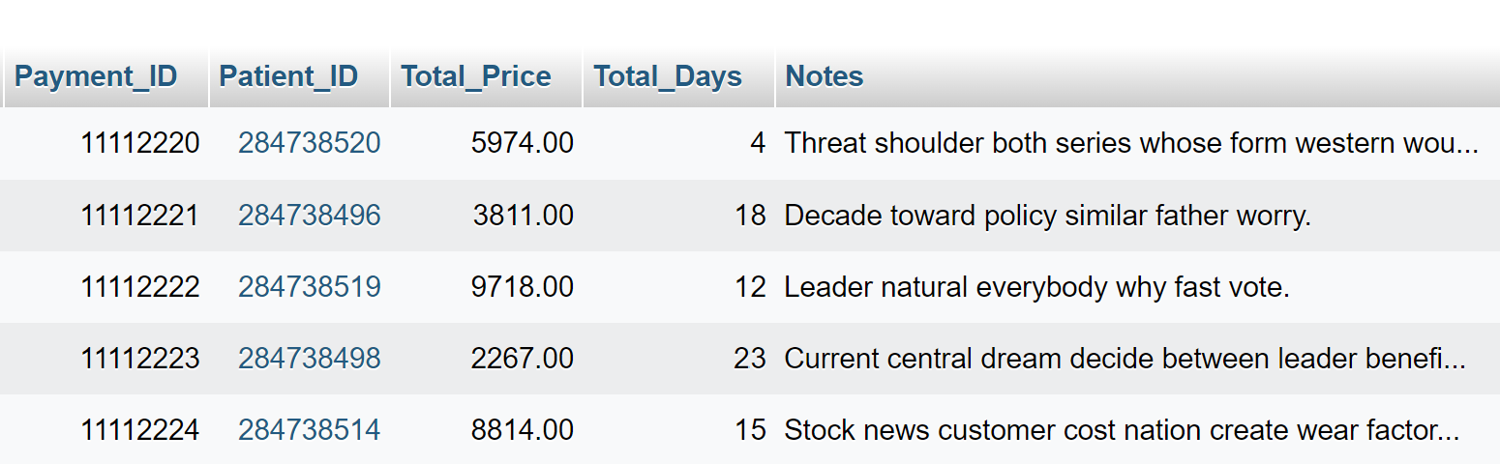
Primary key
Foreign key

Slide 5
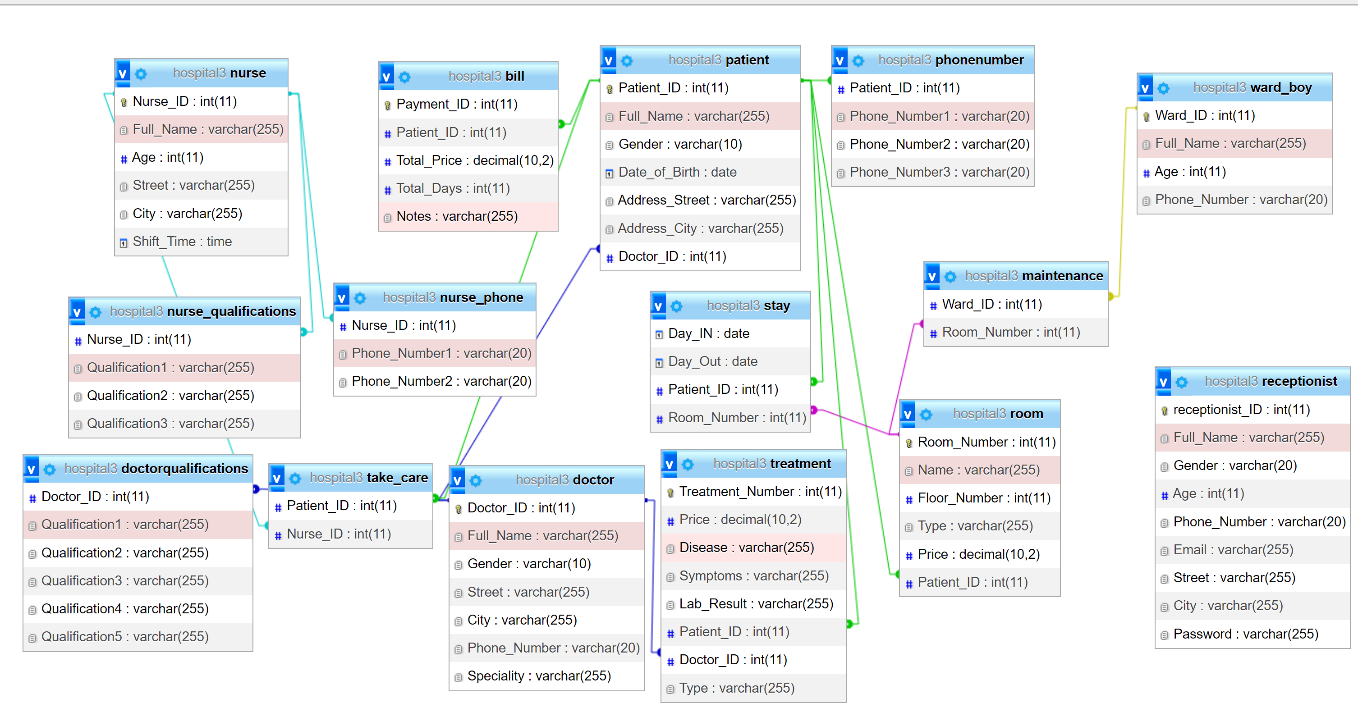

Slide 6
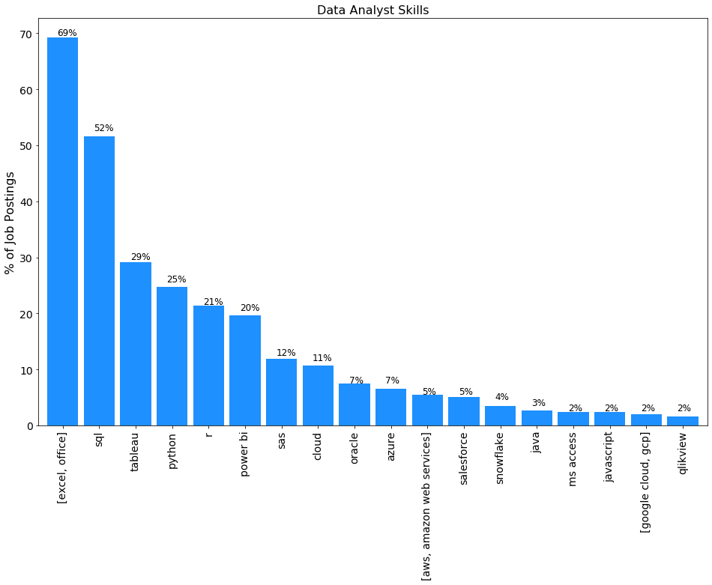

Slide 7
Thank you
Made by Aya Ahmed Mostafa Ali

